Slide 1


Student Affairs System
Requirements

Slide 2
Team Members
أسماء فتحي أبو عبد الله
إيمان محمد عطا الله
دانا أشرف الشناوي
صفوة فادي الريطي
أحمد طه العشري
أحمد محمد جاد
أحمد خالد الشرباصي
محمد أيمن أبو أربعة
محمد أحمد العدوي

Slide 3

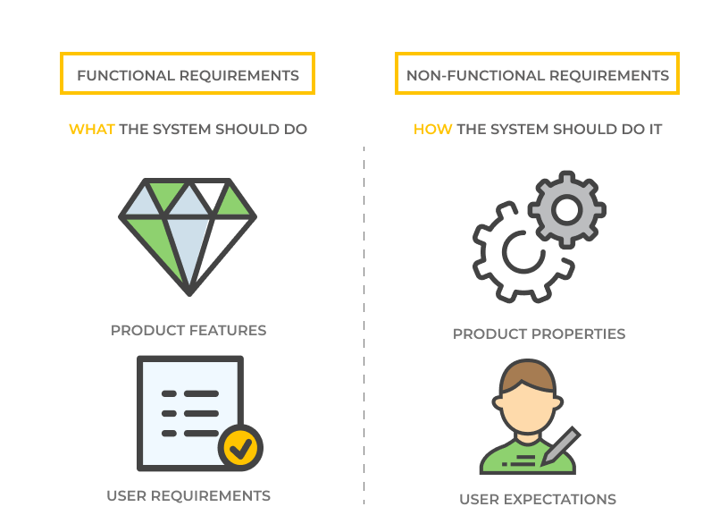
Requirements
Functional
Non-Functional
What The system should do
How The system should do it

Slide 4
Functional Requirements
Management
Staff
Students

Slide 5
Management
Login:
Admin can login by Email
Reset password.
2. Take Backup:
Manage backup for the system continuously.
3. Update data:
Update data of users.
4. Provide Technical support:
Show messages of problems and modification requests in the system from employees.
Add Advertisements:
Control show or hide advertisements.
Control and permission:
Add or delete or modify or check user’s account’s information.
Give permission for each user.

Slide 6
Staff
1. Login :
The system allows all employees to log in.
Reset password
2. Enter Student information :
Enrollment Status
The ability to search for a student
Upload a photo of a student
Tuition fees (for the band or for a particular student)
Recruitment data
Student documents
Student affairs report
3. Enter Academic information :
Enter the study regulations
Enter the study programs
Entering school teams
Add / Edit/ Delete/ arrange courses
Specialization

Slide 7
4. Specify exams :
Add exams
Seating numbers distribution
Distribution of examination committees
Report on the distribution of students to the committees
5. Control results :
Enter course grades
Enter cumulative results:
total summation
The grand total he got
Total score
The ratio
6. Distribution of tasks :
Total employee activity:
Operations performed by the user
Date of completion of operations
Operations completion hour

Slide 8
Students
1. Login :
The system allows the student to log in using id and password.
Reset password.
2. Displays the student's data :
Personal data - previous qualification - in case of transferring to other college or institute - specialization
Providing a university email for each student.
Presenting a case statement for each student.
3. Academic registration :
Subjects
The desires of bifurcation
4. Payment details :
Display payment details about expenses and books

Slide 9
5. Schedule :
The academic schedule.
The mid-year, practical and final exams schedules.
6. Student progress :
The system monitors the absence of each student and warns in case of warnings
The expected results to the student in the coming year after the result appears.
7. Technical support :
Providing a mailbox for the student as a technical support service within the system
Presenting the result:
Do Questionnaires For materials
Show the result academy

Slide 10
Non-Functional Requirements
Operational
Performance
Security
Cultural & Political

Slide 11
Operational
Cross platforms.
The system will be user friendly, consistent, intuitive and descriptive UI.
The system should have a maximum of 2:3 clicks to reach any content.
The system should support notifications.
The system should be evolvable, scalable, testable and maintainable.
The system should be interoperable with secondary university systems.
Performance
Quick ask & response (under 2 sec).
The system should be available 24 hours a day.
20 minutes are specified daily on a fixed date [3 am (low-intensity hours)] to maintain and update the system.

Slide 12
Security
The system must protect the user’s privacy.
Every student should have a user-customizable visibility policy for his/her personal information such as email and study timetable.
The system will be secure and cannot affect, harm, damage the students or all users in general or their devices.
Cultural & Political
The system should provide commonly used calendar formats.
The system should use a related time zone.
The system should use the currency of our country.
The system should provide language support for all students.

Slide 13
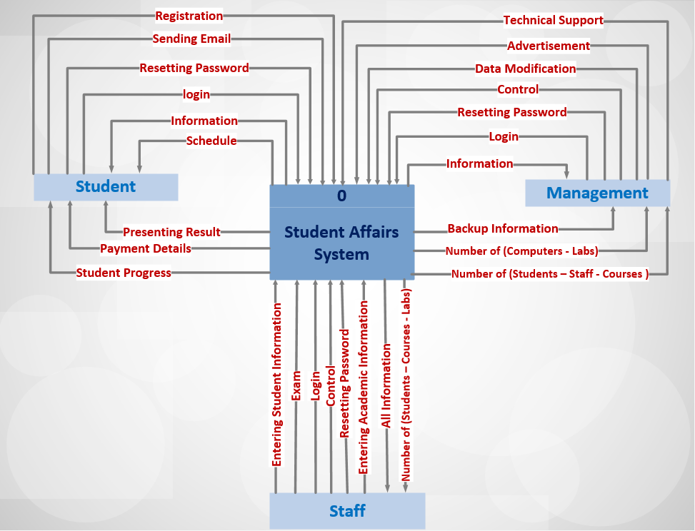
Context Diagram

